Slide 1


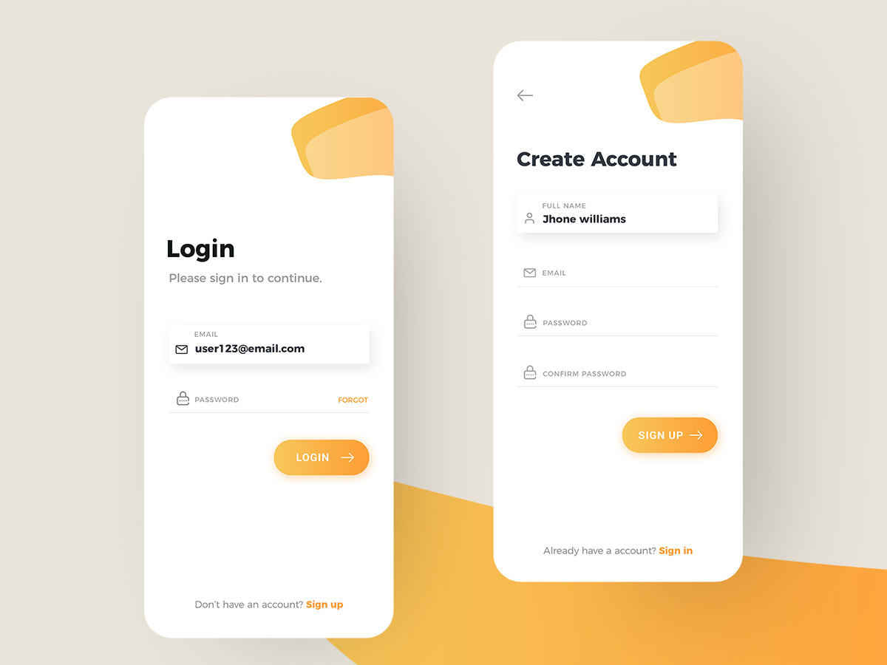
LOGIN
Login
OTP
Password
Please sign in to continue.
Please enter OTP to login.
Please enter password to login.
Email ID / Mobile number
OTP
Password
SUBMIT
LOGIN
LOGIN

Slide 2
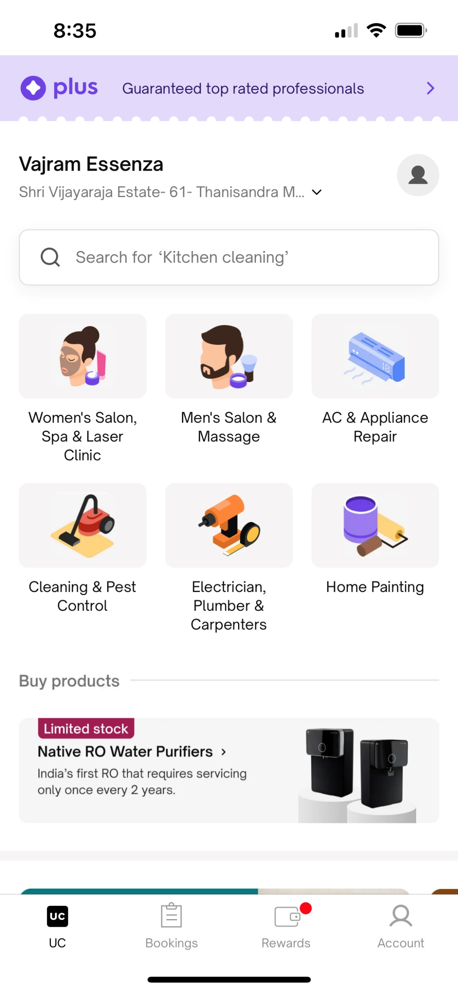







Login As
Login as
Please select you are user or vendor
to continue.
Vendor
User
SUBMIT

Slide 3


SIGNUP
Sign up
OTP
Email OTP
Please sign up to continue.
Please enter OTP to login.
Please enter OTP to login.
Full Name
OTP
Password
Mobile Number
Email ID
Password
Confirm Password
Submit

Slide 4





Register as Vendor
Register Services
Register Services
Locate Me
Please select service type
Please enter details
Vendor/Shop Name
Contact Number
Address Line 1
Address Line 2
Address Line 3
City
State
Pin
Submit
Submit

Slide 5
FORGOT password
Forgot password?
OTP
Email OTP
Please enter email / mobile number
to continue.
Please enter OTP to login.
Please enter OTP to login.
Email ID / Mobile number
OTP
Password
Submit

Slide 6
RESET password
Reset Password
Please enter old and new password to
continue.
Old Password
New Password
Confirm New Password
Submit

Slide 7
RESET password
Reset Password
Please enter old and new password to
continue.
Old Password
New Password
Confirm New Password
Submit

Slide 8

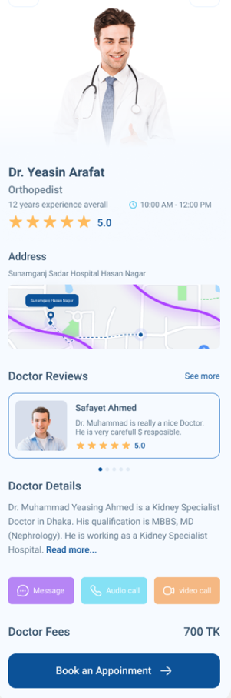
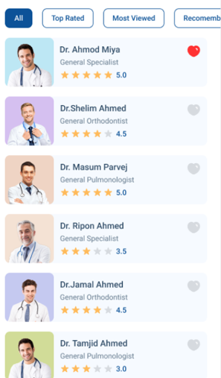



List
Bike Services

Slide 9
Hecko
#F6851F
#32AD97
#F6851F
#4CB853
#F8961D
#2C9C48
#E01F27
SERVICES AT YOUR TIPS

Slide 10
Hecko
Hecko
SERVICES AT YOUR TIPS
SERVICES AT YOUR TIPS

Slide 11
Signup
- Email -> OTP, passssword -> Sign up as (Vendor or Client) -> Login as (Vendor or Client) -> Home
- Phone -> OTP -> Sign up as (Vendor or Client) -> Login as (Vendor or Client) -> Home
Signin
- Email -> passssword -> Login as (Vendor or Client) -> Home
- Phone -> OTP -> Login as (Vendor or Client) -> Home
Future time open
--> Home

Slide 12
Account
Login AS -> Login as (Vendor or Client) -> Home
Manage Addresses – add/remove/edit (Add phone with OTP, cannot remove all phone numbers)
Personal Info (Email change with OTP, Phone change with OTP)
Screen to change vendor info
Screen to change client info
Change password
Favorite vendors
Past Services
For client – Date wise
For vendors – date wise
My Services
Vendor should be able to select services they provide + add relevant products for that services + add price + add normal duration of service
My ratings (screen will show overall rating for service done and on double click the detail ratings)
Settings ( delete account – will just make account inactive)
Logout

Slide 13
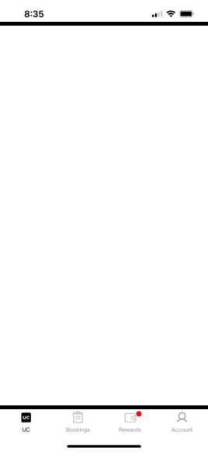
























Vendor Home Screen
Vendor Bookings Screen
Vendor Packages
Vendor Account
Shop Name
Shop Name
Shop Name
Full Name
Address of location...
Address of location...
Address of location...
test@gmailcom
Search for ‘Brand / Number / Owner Name’
Search for ‘Brand / Number / Owner Name’
Search for ‘Package / Service’
+91 - 98762323
Owner Name (Bike Number)
Owner Name (Bike Number)
Package Name (My Price: / Avg Price: )
Contact Support
Package / Service Type
Date: Tomorrow (Tuesday, 08-Aug-23)
Services: 23 [Oil change, cleaning, etc]
Estimated Value: ????
36%
Estimated Value: ????
Duration: 8 hours
Login As
Vendor
Accept
Reschedule
Reject
4.5
Owner Name (Bike Number)
Owner Name (Bike Number)
Package Name (My Price: / Avg Price: )
Manage Addresses
3
Package / Service Type
Date: Tomorrow (Tuesday, 08-Aug-23)
Services: 23 [Oil change, cleaning, etc]
Estimated Value: ????
36%
Estimated Value: ????
Duration: 8 hours
Reschedule
Reject
4.5
Change Password
21-Sept-23
Owner Name (Bike Number)
Owner Name (Bike Number)
Package Name (My Price: / Avg Price: )
Package / Service Type
Date: Wednesday, 09-Aug-23
Services: 23 [Oil change, cleaning, etc]
Past Services
45
Estimated Value: ????
36%
Estimated Value: ????
Duration: 8 hours
4.5
Accept
12-Aug-23
Reject
Owner Name (Bike Number)
Owner Name (Bike Number)
Package Name (My Price: / Avg Price: )
My Services
1023
Package / Service Type
Date: Thursday, 10-Aug-23
Services: 23 [Oil change, cleaning, etc]
Estimated Value: ????
36%
Estimated Value: ????
Duration: 8 hours
4.5
My Products
23
Accept
Reschedule
No Time
Owner Name (Bike Number)
Owner Name (Bike Number)
Package Name (My Price: / Avg Price: )
My Ratings
4.4
Package / Service Type
Date: Thursday, 10-Aug-23
Services: 23 [Oil change, cleaning, etc]
Estimated Value: ????
36%
Estimated Value: ????
Duration: 8 hours
4.5
Accept
Reschedule
Reject
Settings
Home
Bookings
Packages
Account
Home
Bookings
Packages
Account
Home
Bookings
Packages
Account
Home
Bookings
Packages
Account

Slide 14


Add Package
Package Name’
Cleaning Services (Rs. 1120)
Wax & Water (Rs. 120)
Products (Rs 10)
Search for ‘Service’
Water wash
Rs 120
Search for ‘Product Name’
Search for ‘Service / Service Name / Group’
Water wash
Rs 120
Products / Product Name
Rs 0
Package Summary (Rs 1200)
XYZ wax
Rs 10
Cleaning Services (2 / 10)
Rs 120
Wax & water
Rs 0
Rs 10
XYZ wax
Oil Change (0 / 10)
Rs 0
Cloth cleaning only
Rs 1000
Engine service (10 / 10)
Rs 1000
Tyre services (1 / 2)
Rs 100
Headlight change (1 / 1)
Rs. 100
5% lower than average
Break repair (1 / 1)
Rs. 10
6% higher than average
Break change (1 / 1)
Rs. 89
Gear repair (1 / 5)
Rs. 123
5% lower than average
Home
Bookings
Packages
Account
Home
Bookings
Packages
Account
Home
Bookings
Packages
Account
Home
Bookings
Packages
Account

Slide 15
Vendor Screen
Client Screen
Home
Bookings
Services
Account
Home
Bookings
Services
Account

Slide 16


Vendor
Client
Should see services in progress for today
Should see list of all services providers
Categories of services
Catalog of services, price, duration, products
Add/delete/modify
Group of services – kind of packages
List of favorite service providers by category
Should See bookings for upcoming days
Reject/Accept
Available to take booking or not
My past services
Account Menu
Account Menu

